Slide 1
Towards Multiscale Modeling of Swift Heavy-Ion Track Formation in Redox Active Materials
Grady Clopton, Elif Ertekin May 8, 2027

Slide 2
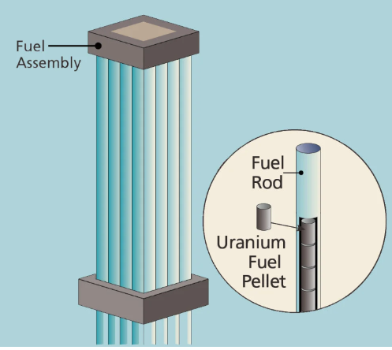
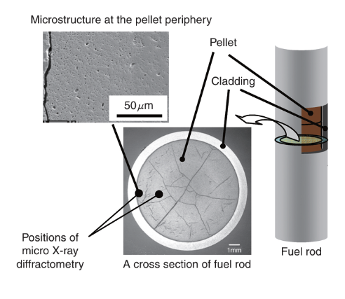
Radiation Damage in Nuclear Fuels
Nuclear fuel operates in a severe radiation environment. Fission damage accumulates in UO2 pellets leading to
Lower thermal conductivity (defects scatter phonons)
Swelling and micro-cracking (pellet-cladding stress)
Fission-gas retention and release
Reduced fuel lifetime and tightened safety margins
Damage physics happens to fast, too small to measure directly. Swift heavy ion tracks form in picoseconds across nanometer scales.
CeO2 is a non-radioactive surrogate for UO2. Same fluorite structure, same f-electron redox chemistry, with a much larger SHI experimental database.

Slide 3



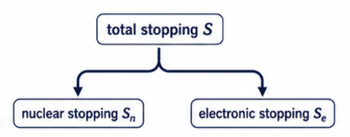
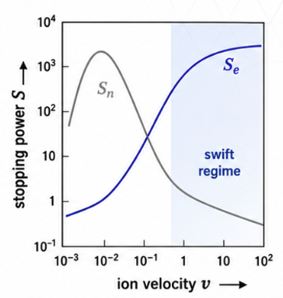
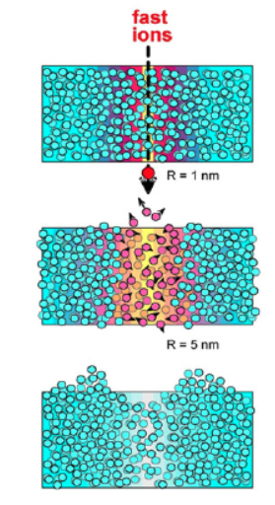


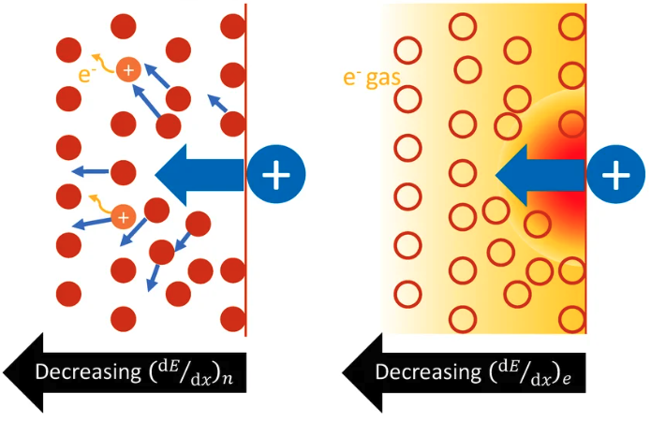



Swift heavy Ions: Stopping Power and Energy-Loss Channels
In the swift regime, energy is lost mainly to electrons - the atomic damage appears only after electron-lattice coupling.
SHI tracks are driven by electronic stopping, not by an ordinary collision cascade.
The latent track is the surviving damaged cylinder after the thermal spike.

Slide 4




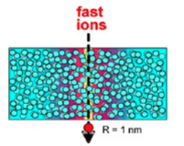
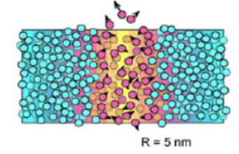
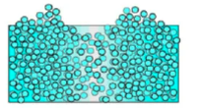
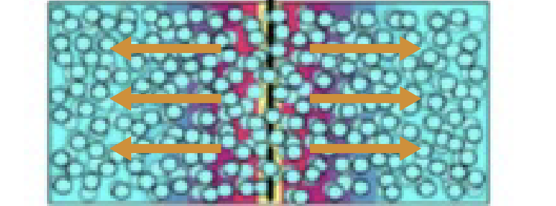
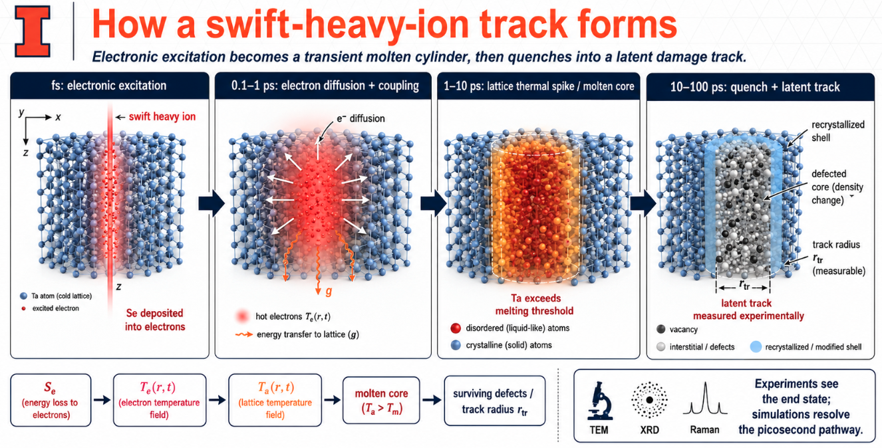
How a Swift-Heavy-Ion Track Forms
Energy Deposited into electrons along Ion Path
Electrons diffuse outward
and transfer energy to the lattice
Lattice heats above the melting point, forming molten cylindrical core
Core recrystallizes,
Leaving a damaged
Latent track
Electronic excitation leads to heating of the crystal lattice, a transient molten cylinder, then quenches into a latent damage track
Experiments see the end state; simulations resolve the picosecond pathway.

Slide 5
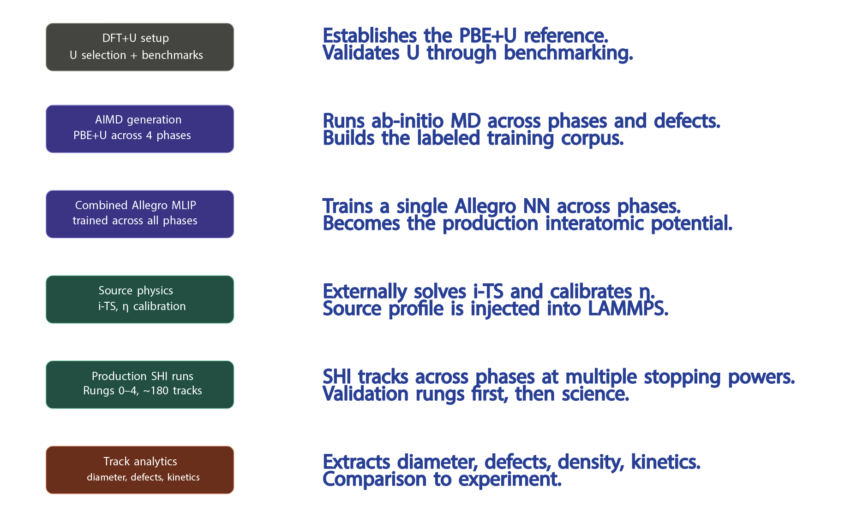
Project Overview

Slide 6
U Selection

Slide 7
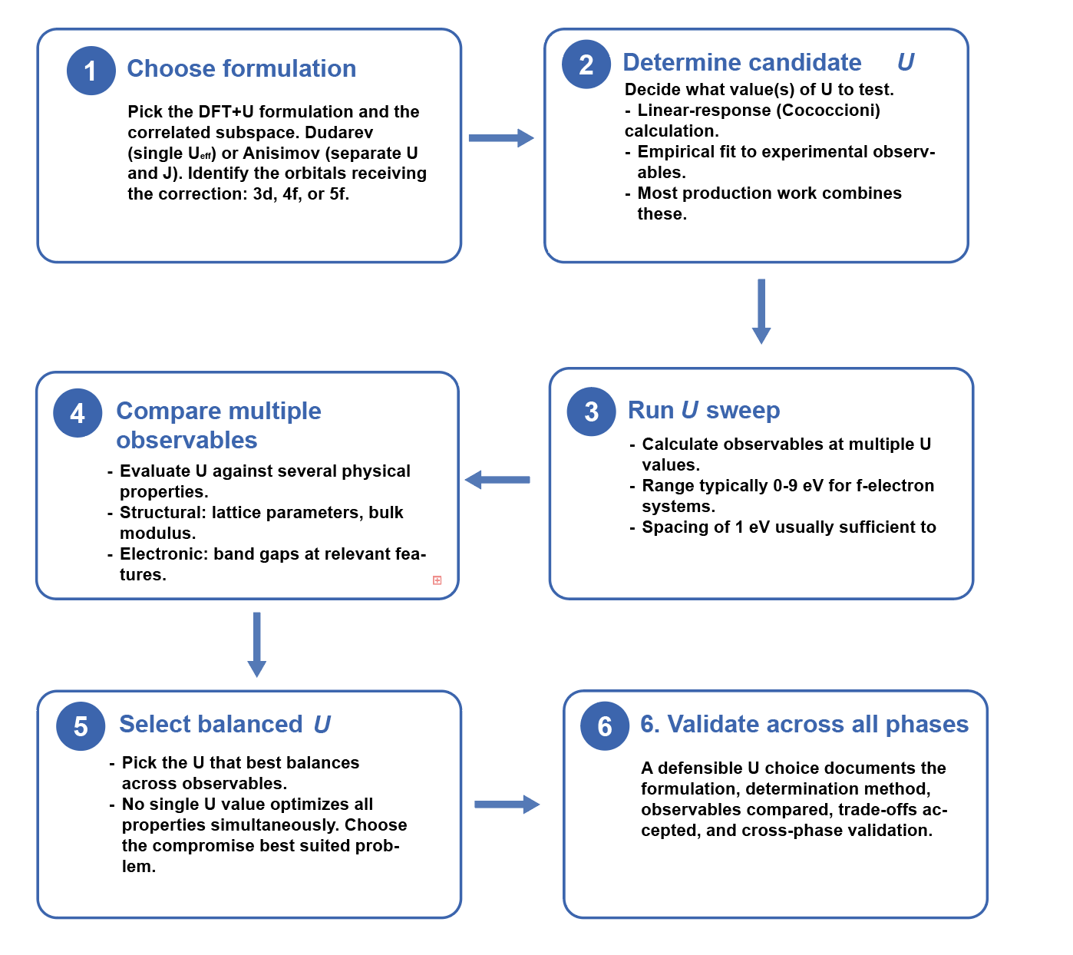
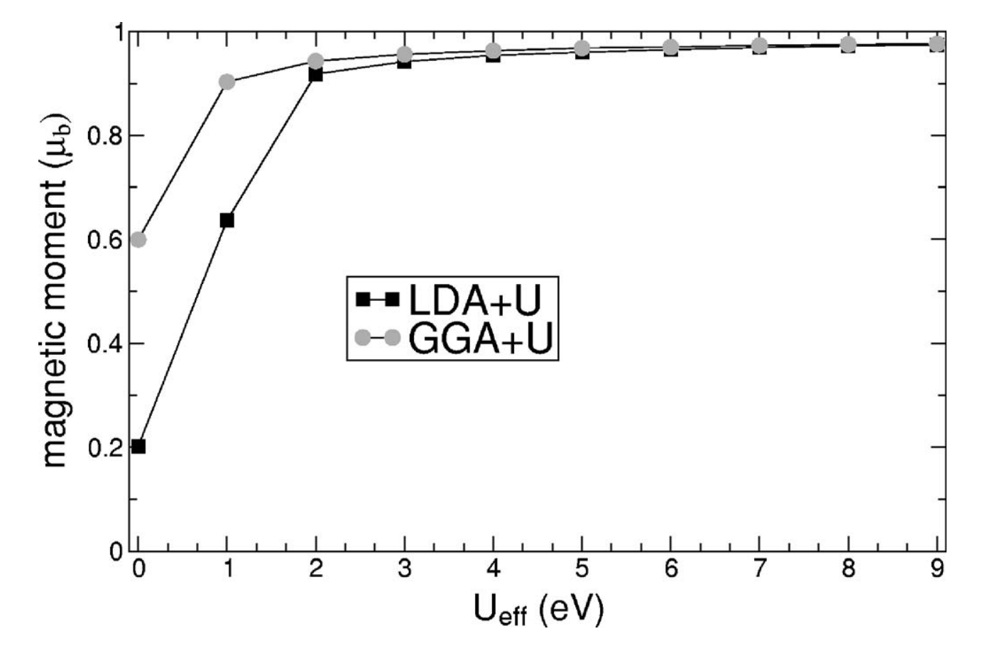
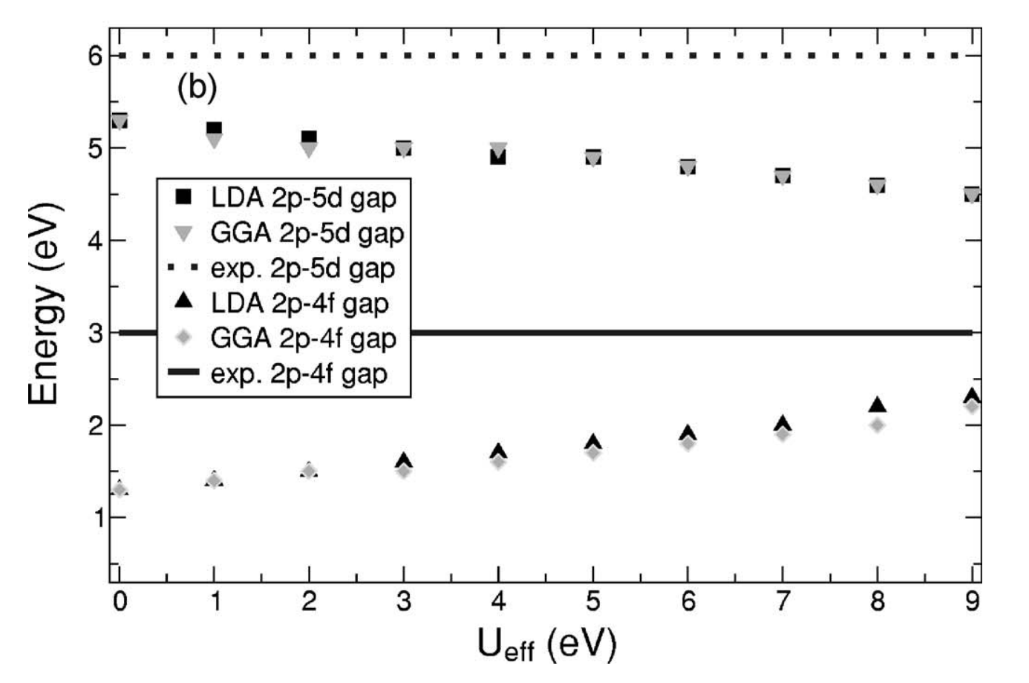
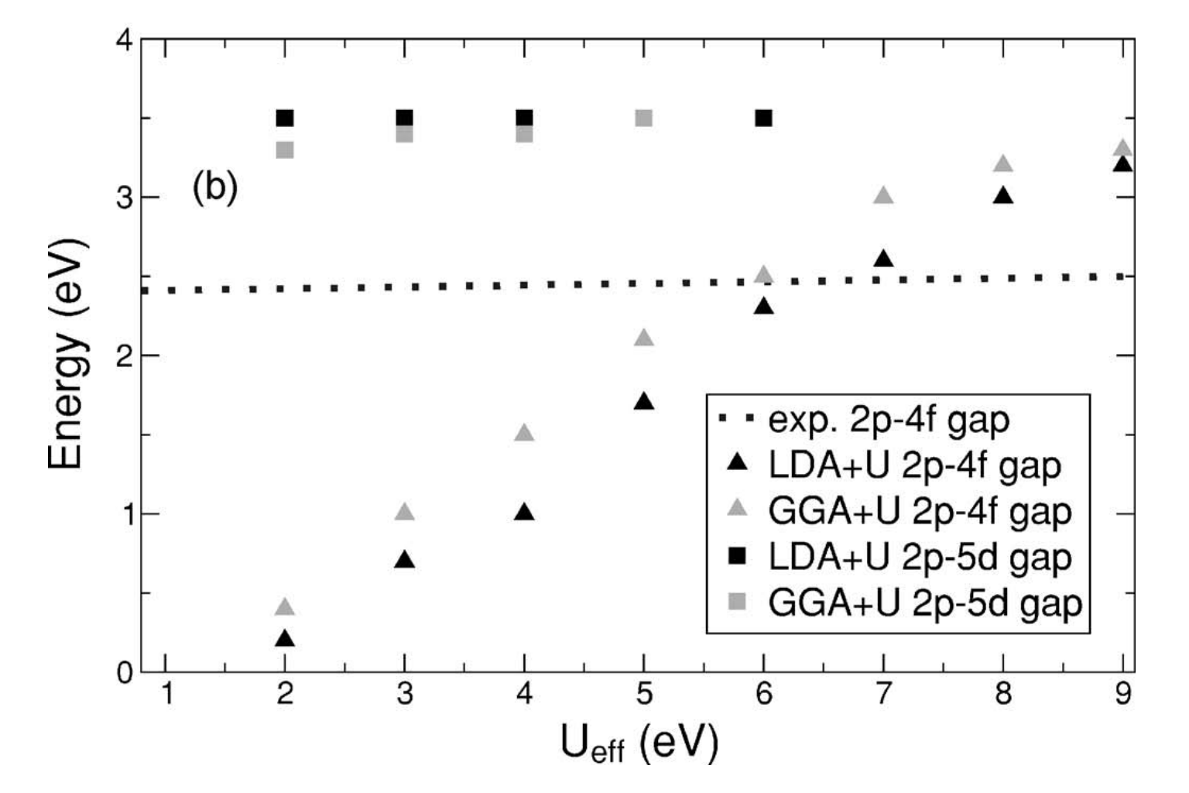
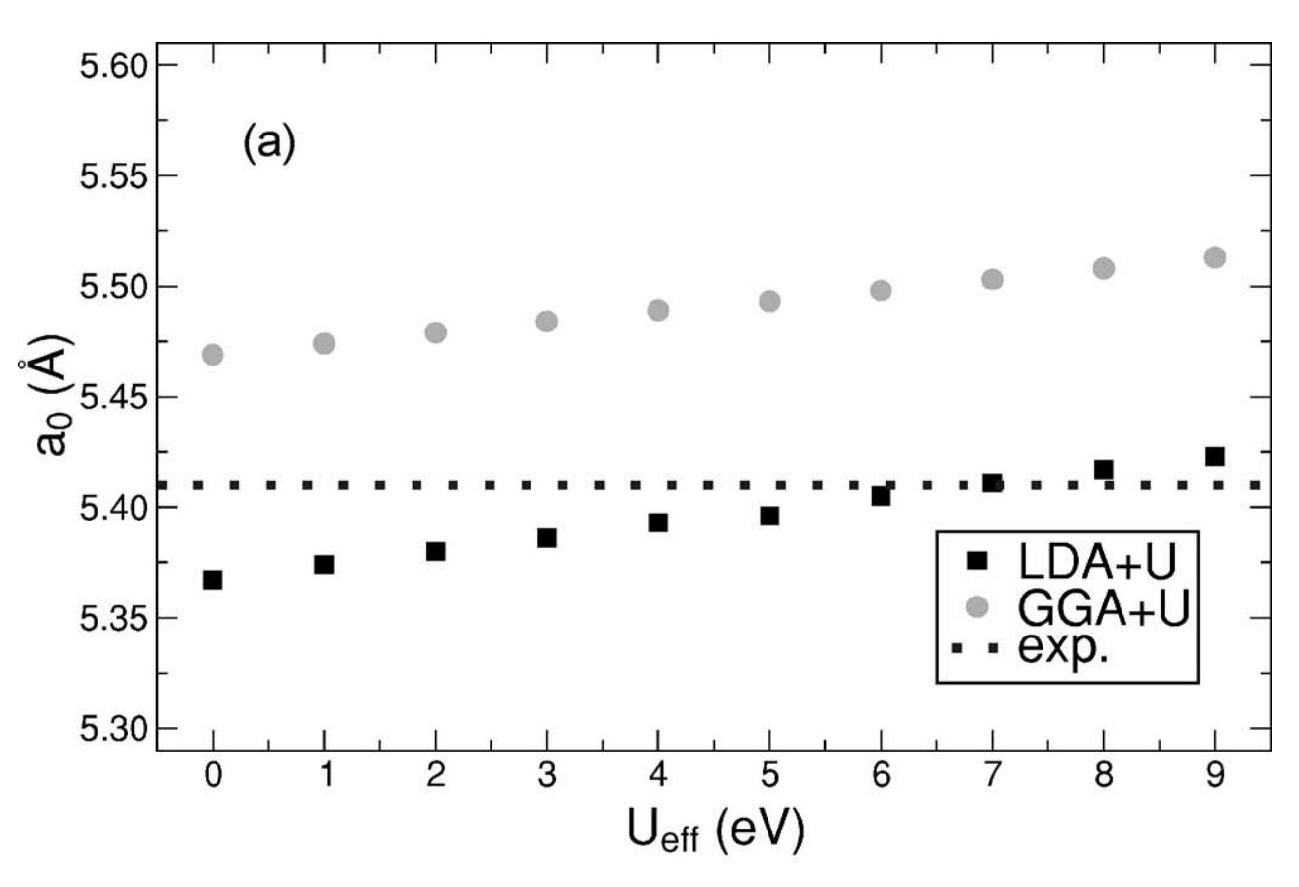
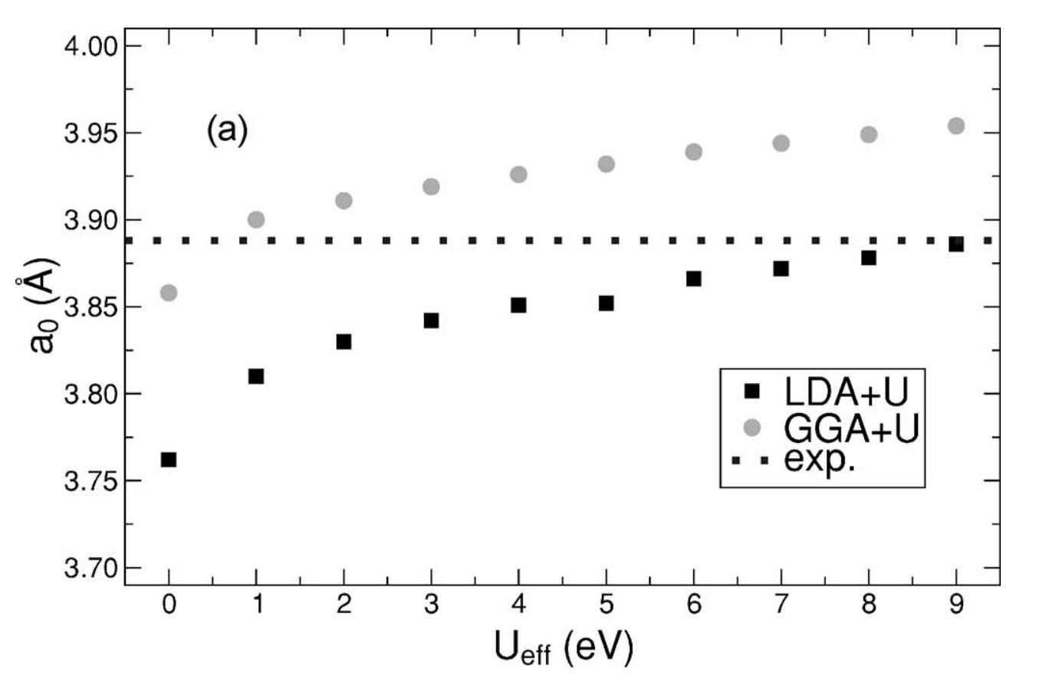
Process for Selecting U: Why is it Challenging?

Slide 8

Process for Selecting U: Why is it Challenging?
U selection is a judgment process supported by data

Slide 9
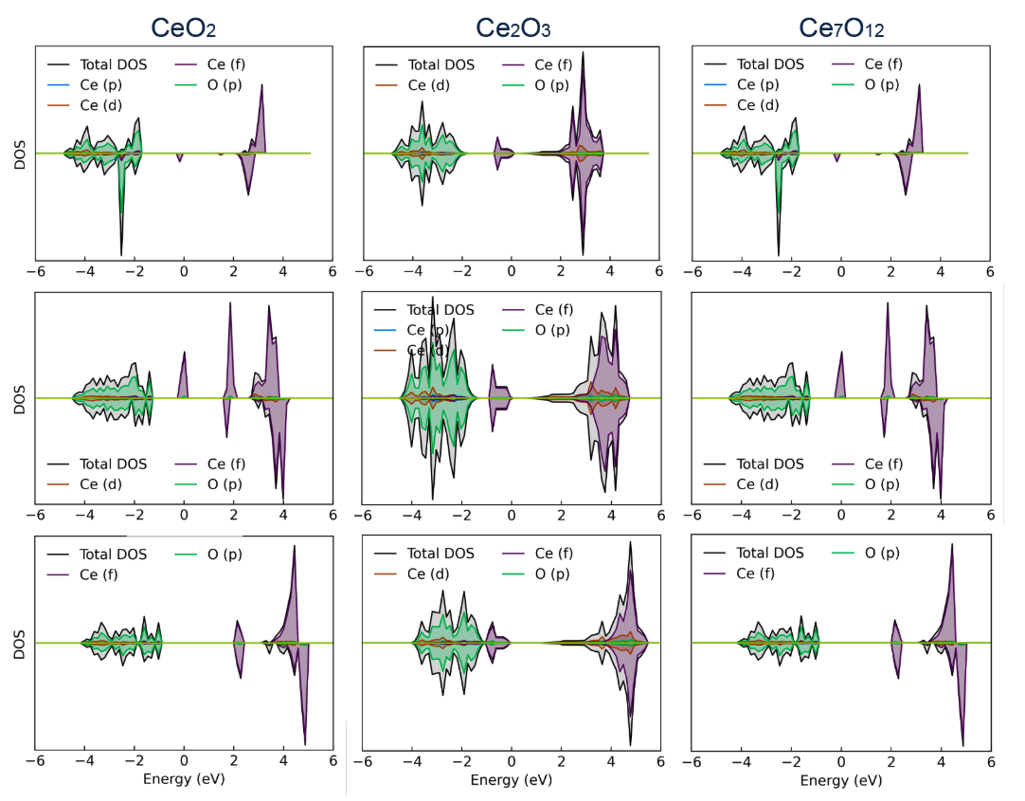
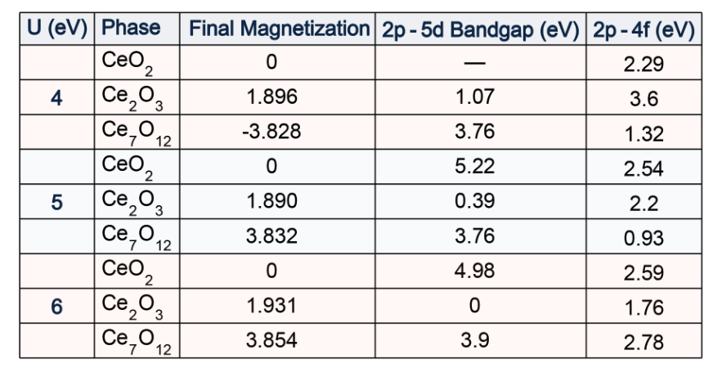
DFT + U Sweep Results (Metastable Solution)
U=4
U=5
U=6

Slide 10
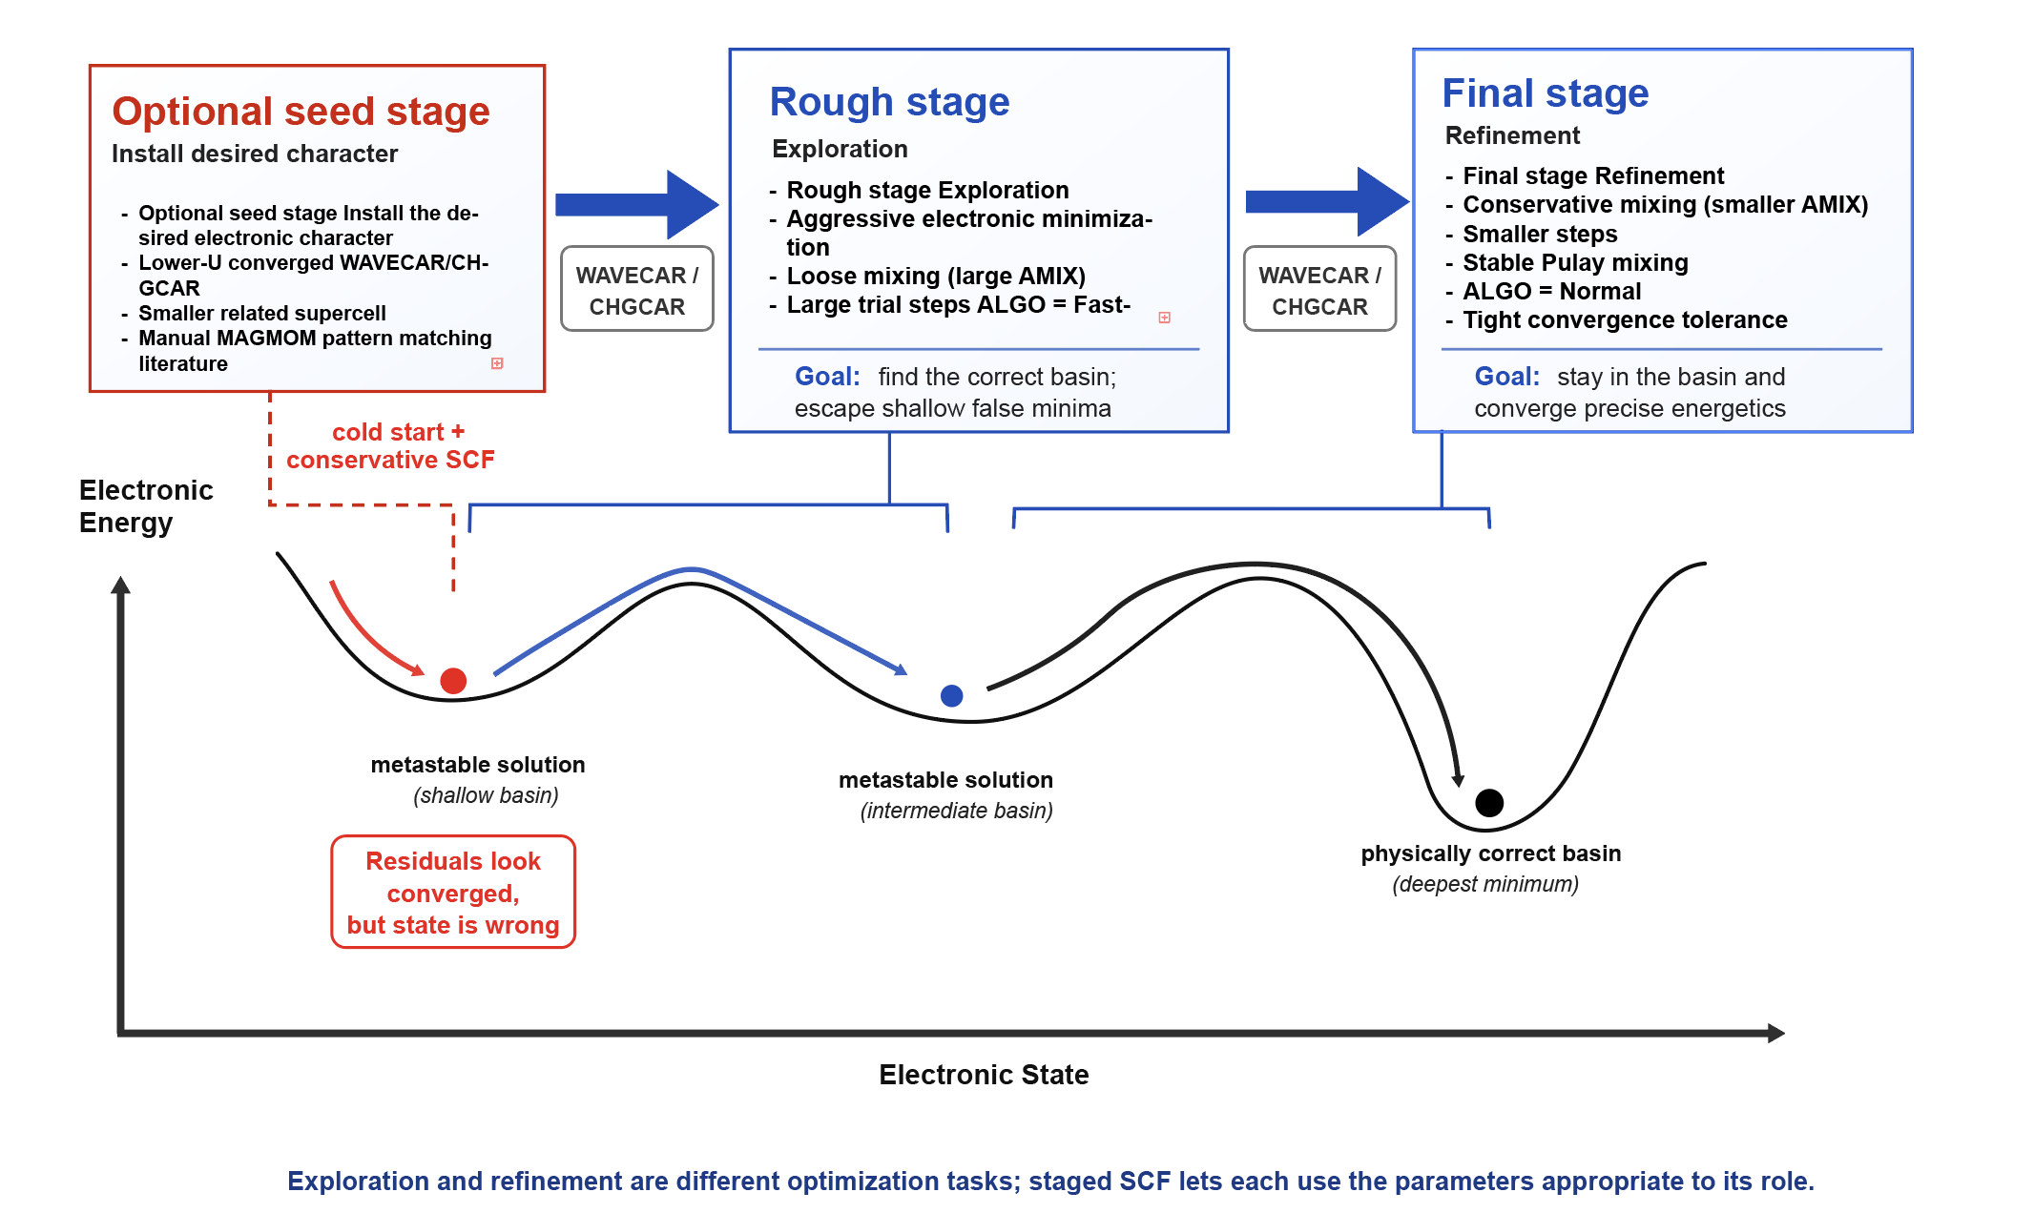
Staged SCF Convergence for Systems with Multiple Electronic Solutions

Slide 11
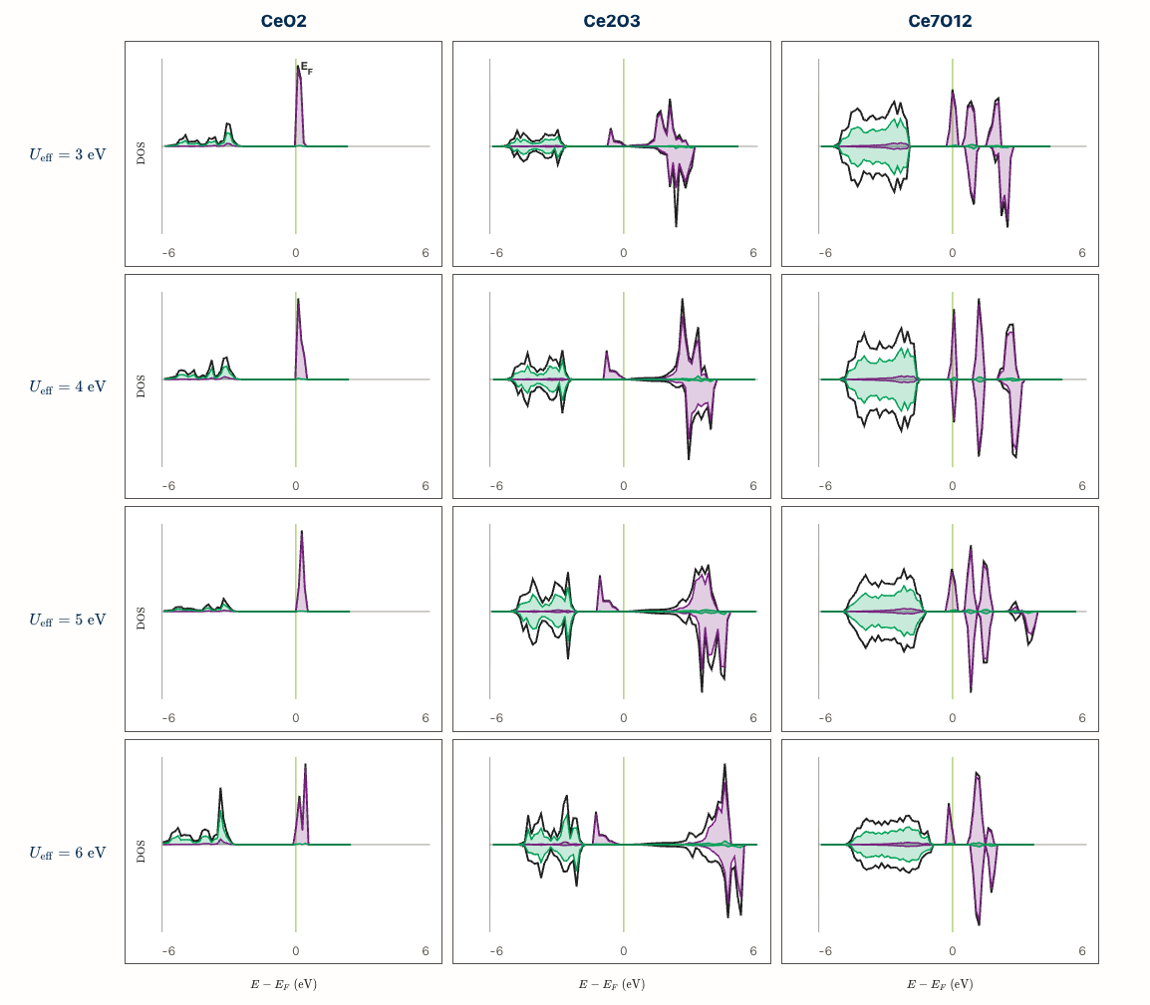
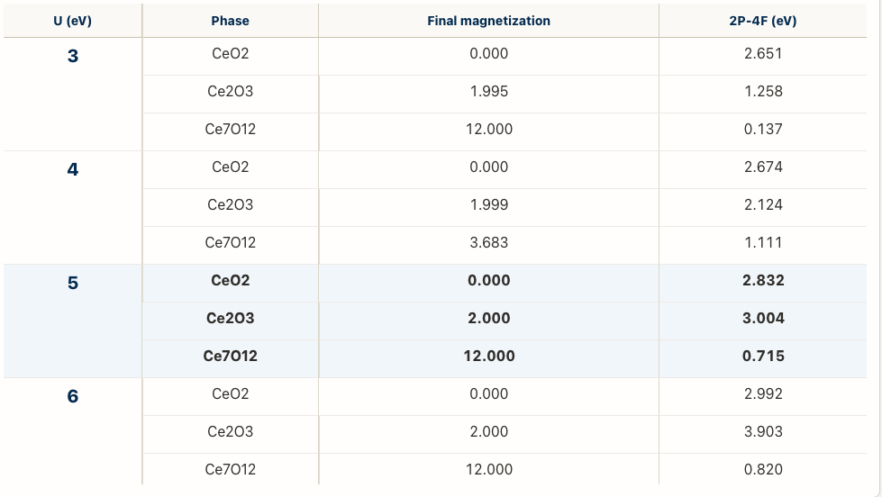
Current DFT + U Sweep Results
U Selection

Slide 12
AIMD Data Generation

Slide 13
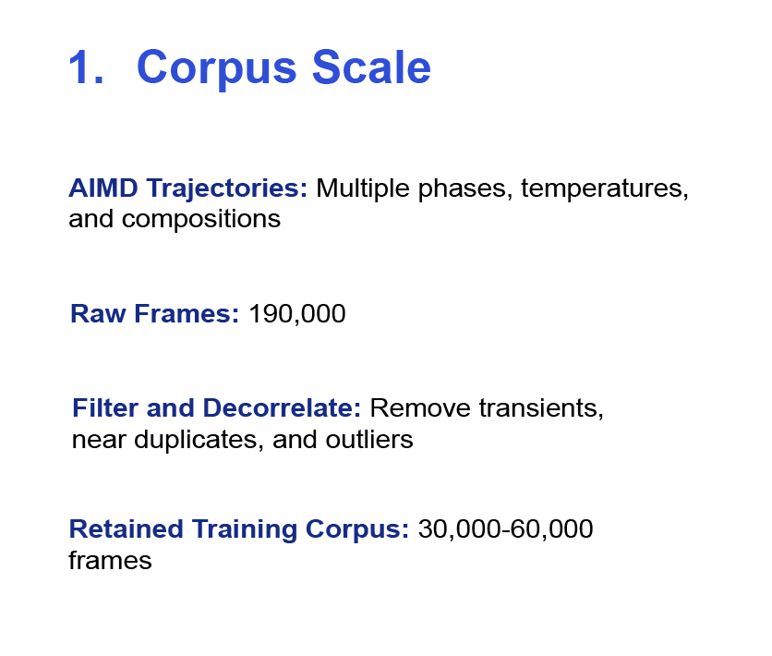
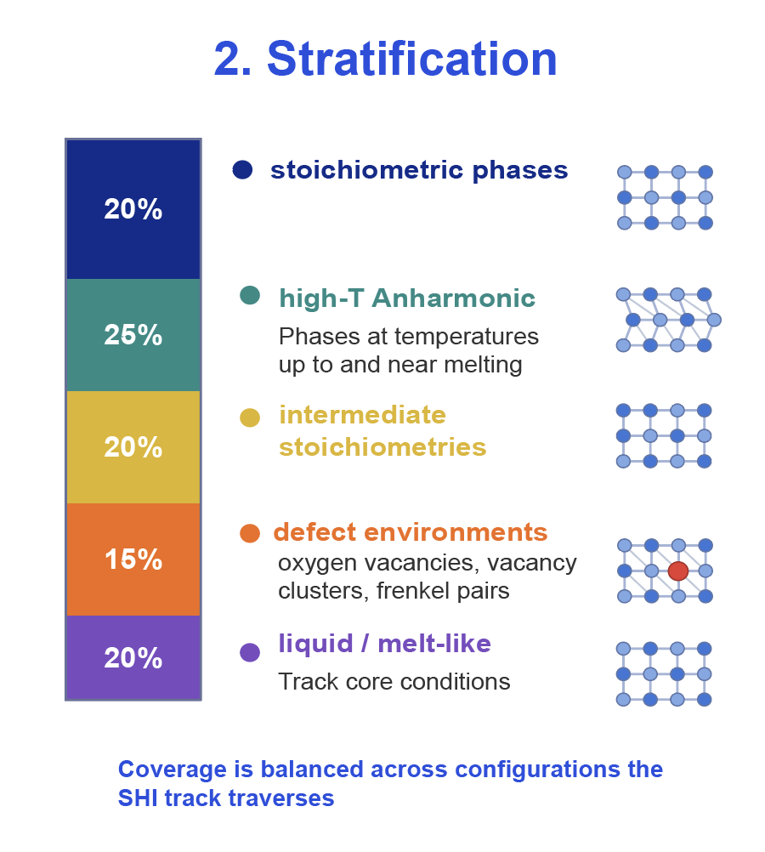
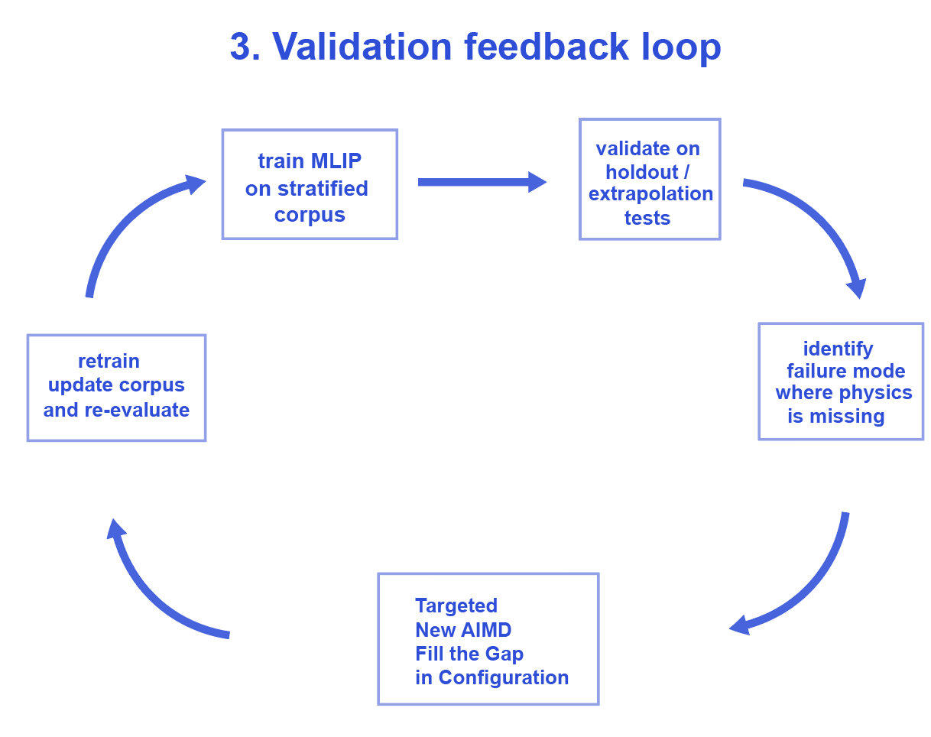
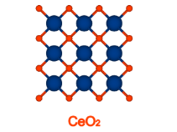
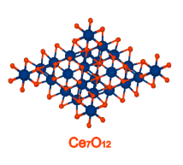
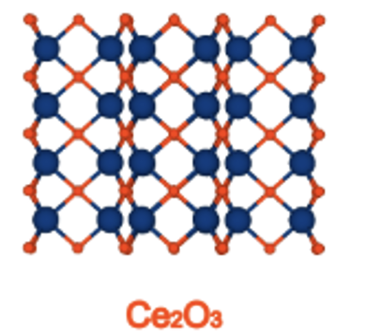
AIMD Generation: Stratified Sampling for Combined Allegro

Slide 14
Allegro MLIP

Slide 15
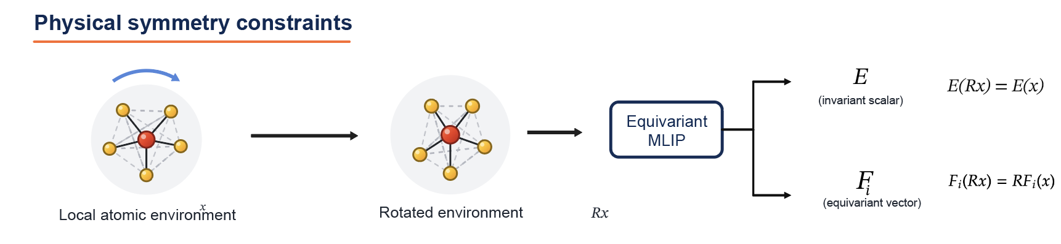
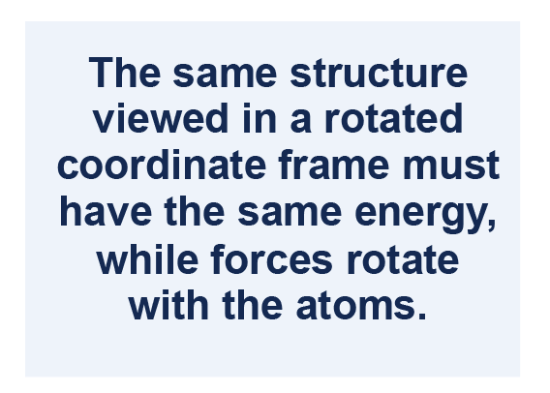
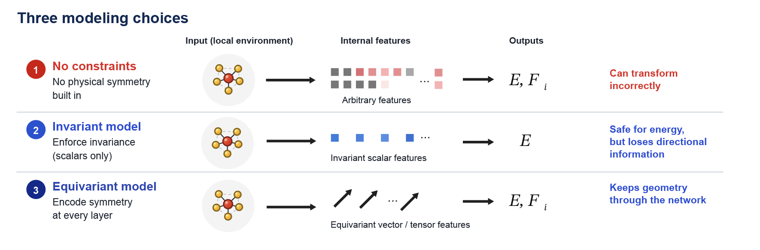
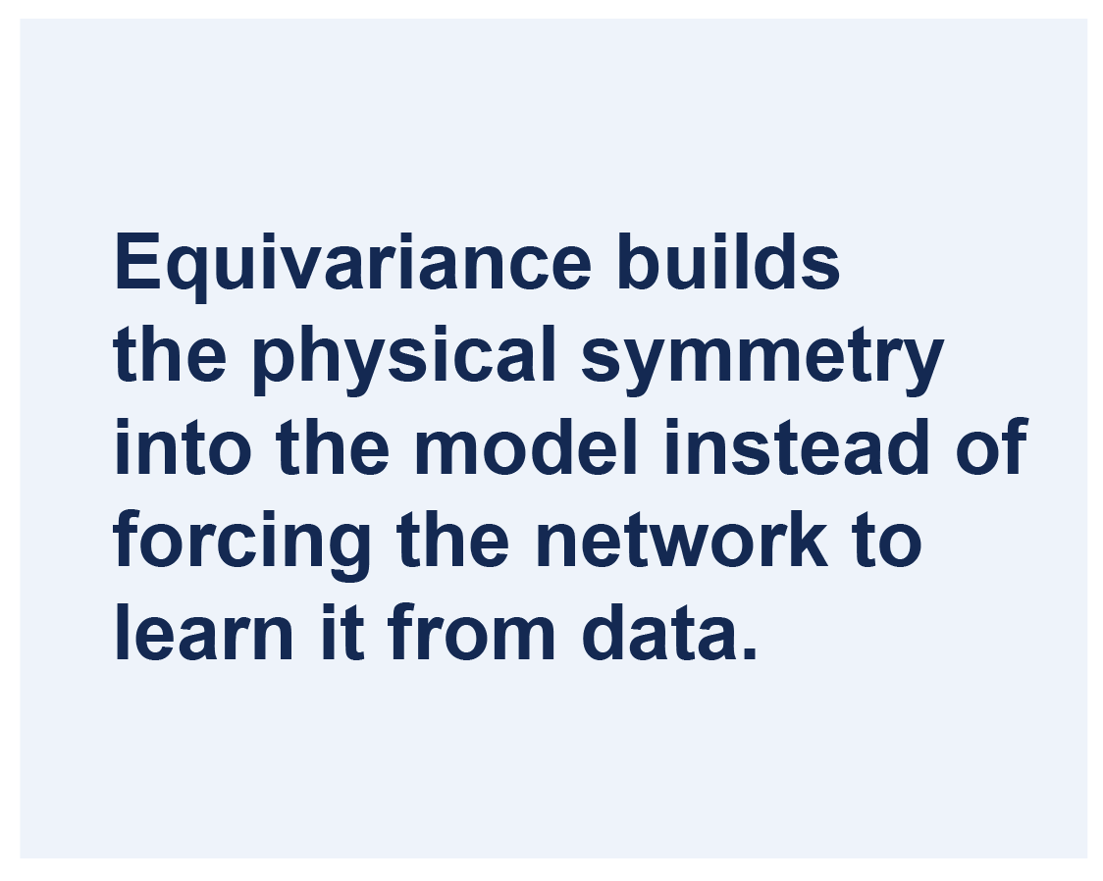
Why Equivariance Matters

Slide 16

Why Allegro Is the Right Choice for Ceria SHI Tracks
1.) What the SHI Problem Demands
Directional Local Physics: local geometry and forces change rapidly in the damaged track core.
Redox Active Chemistry: Ceria samples multiple oxidation states and intermediate stoichiometries
Extreme Environments: High temperature, defects, and non-equilibrium states (including molten-core-like conditions
Large production cells: Track simulations require multi-million atoms systems and long timescales
2.) What the SHI Problem Demands
Rotationally consistent forces and energies: Preserve consistent information and symmetries
Transfer across phases and intermediate stoichiometries: Generalize across oxidized, reduced, and mixed states
Stability in high-temperature off-equilibrium states: Remain robust in disordered defective, and molten-core environments
Linear scaling, local operations with strong GPU parallelism

Slide 17
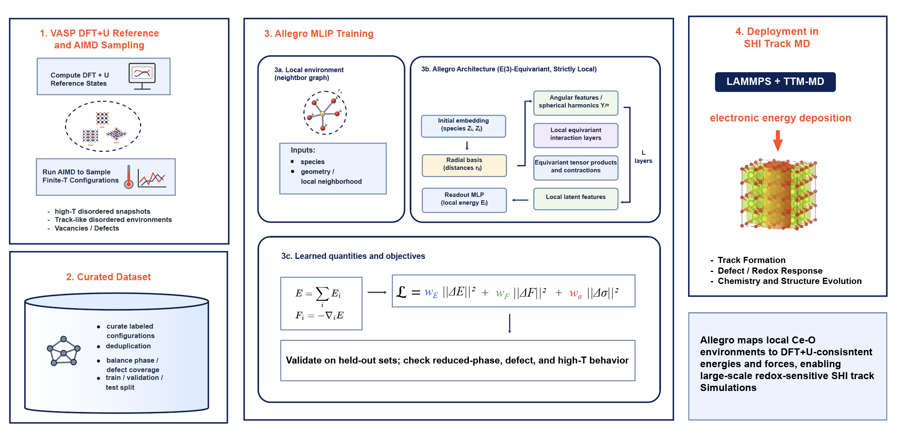
Allegro MLIP for Redox-Active Ceria

Slide 18
Data Generation
Main challenge: in ceria, oxygen vacancies are coupled to Ce⁴⁺/Ce³⁺ redox changes
Training data must therefore capture both atomic distortions and the correct localized 4f electronic state
DFT+U can describe this physics, but reduced ceria often has multiple metastable 4f occupation patterns
We generate data across the ceria reduction series CeO₂, Ce₇O₁₂ Ce₂O₃.
Data Generation Process:
Use ab initio molecular dynamics at multiple temperatures to sample anharmonic, non-equilibrium local environments
Label each configuration with total energies, atomic forces
Notes:
We calibrate and select the parameter U by comparing features like electronic density of states, band gaps, and magnetic moments to experiment.
This is tricky in practice because these compounds exhibit different mixed valence Ce species and different magnetic moments on the Ce atoms.

Slide 19
Source Physics

Slide 20
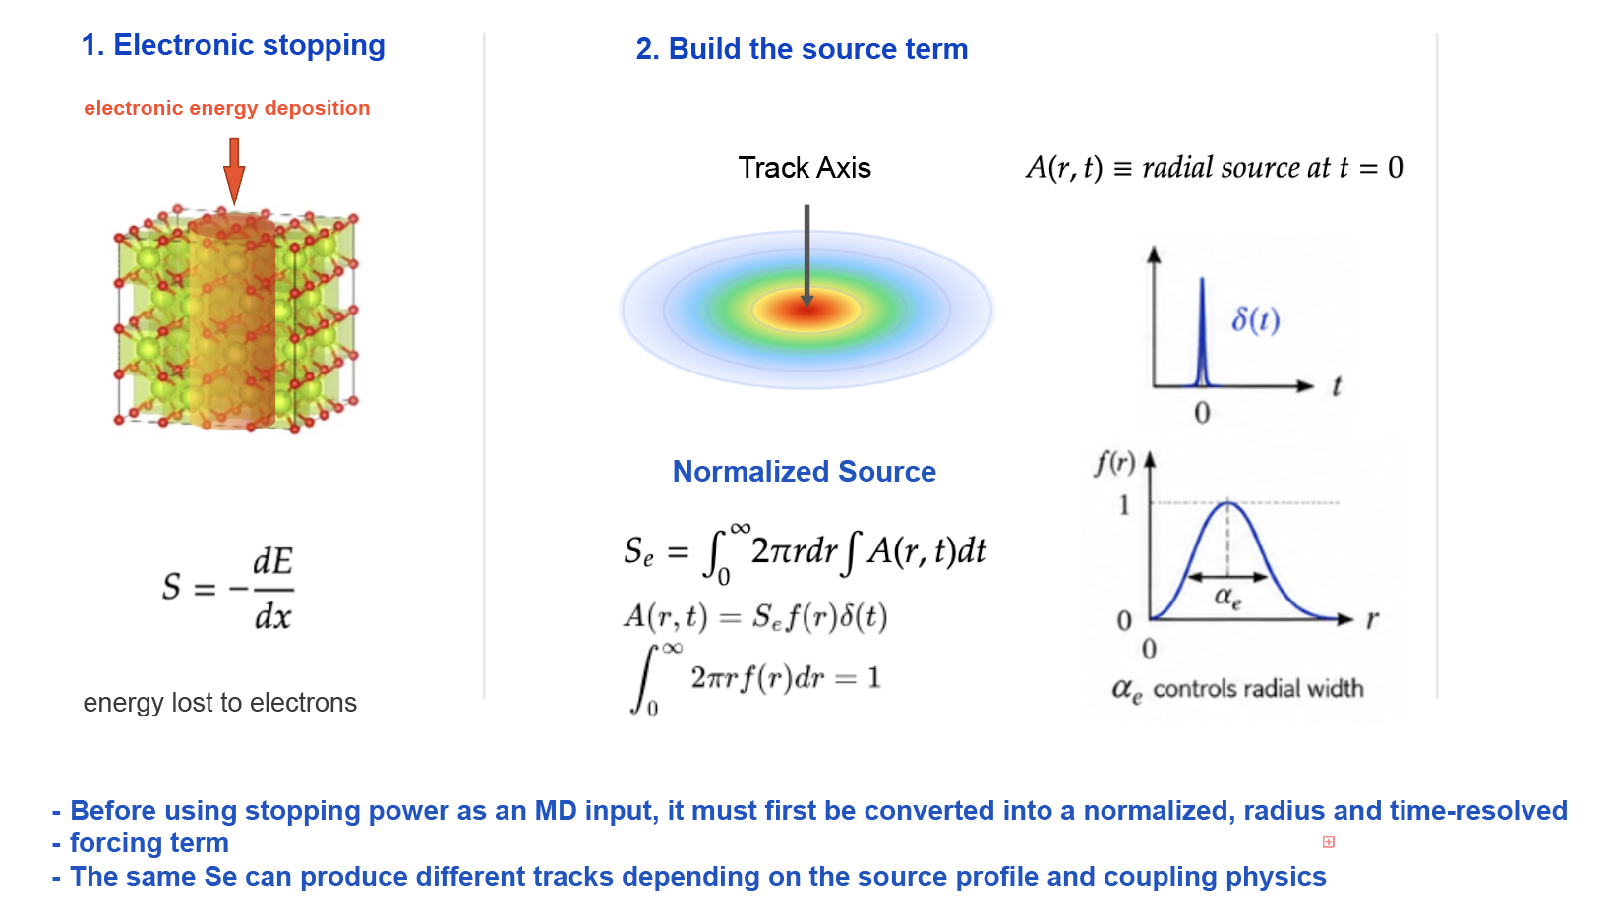
Source Physics: From Stopping Power to Track Formation
Source Physics

Slide 21
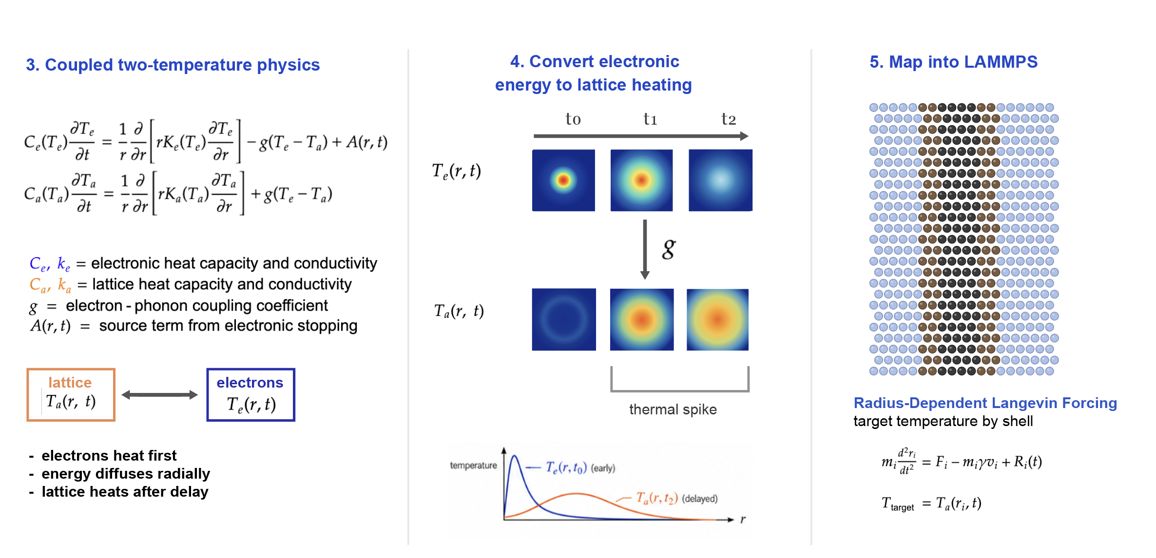
The i–TS Model: Converting Electronic Excitation into Lattice Heating
Source Physics

Slide 22
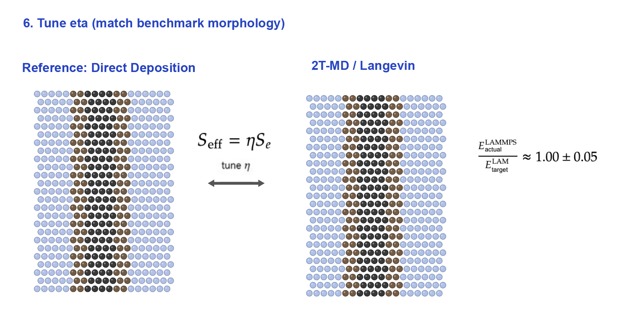
Validation of Track Formation
Source Physics

Slide 23
SHI Track Simulations Analytics

Slide 24
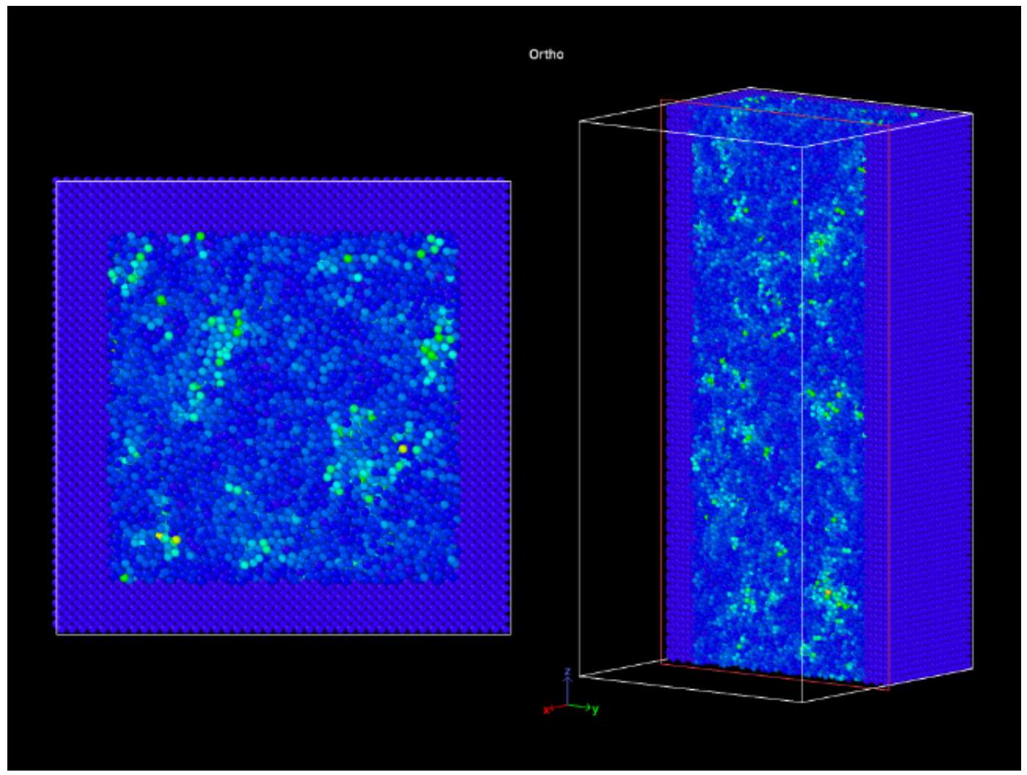
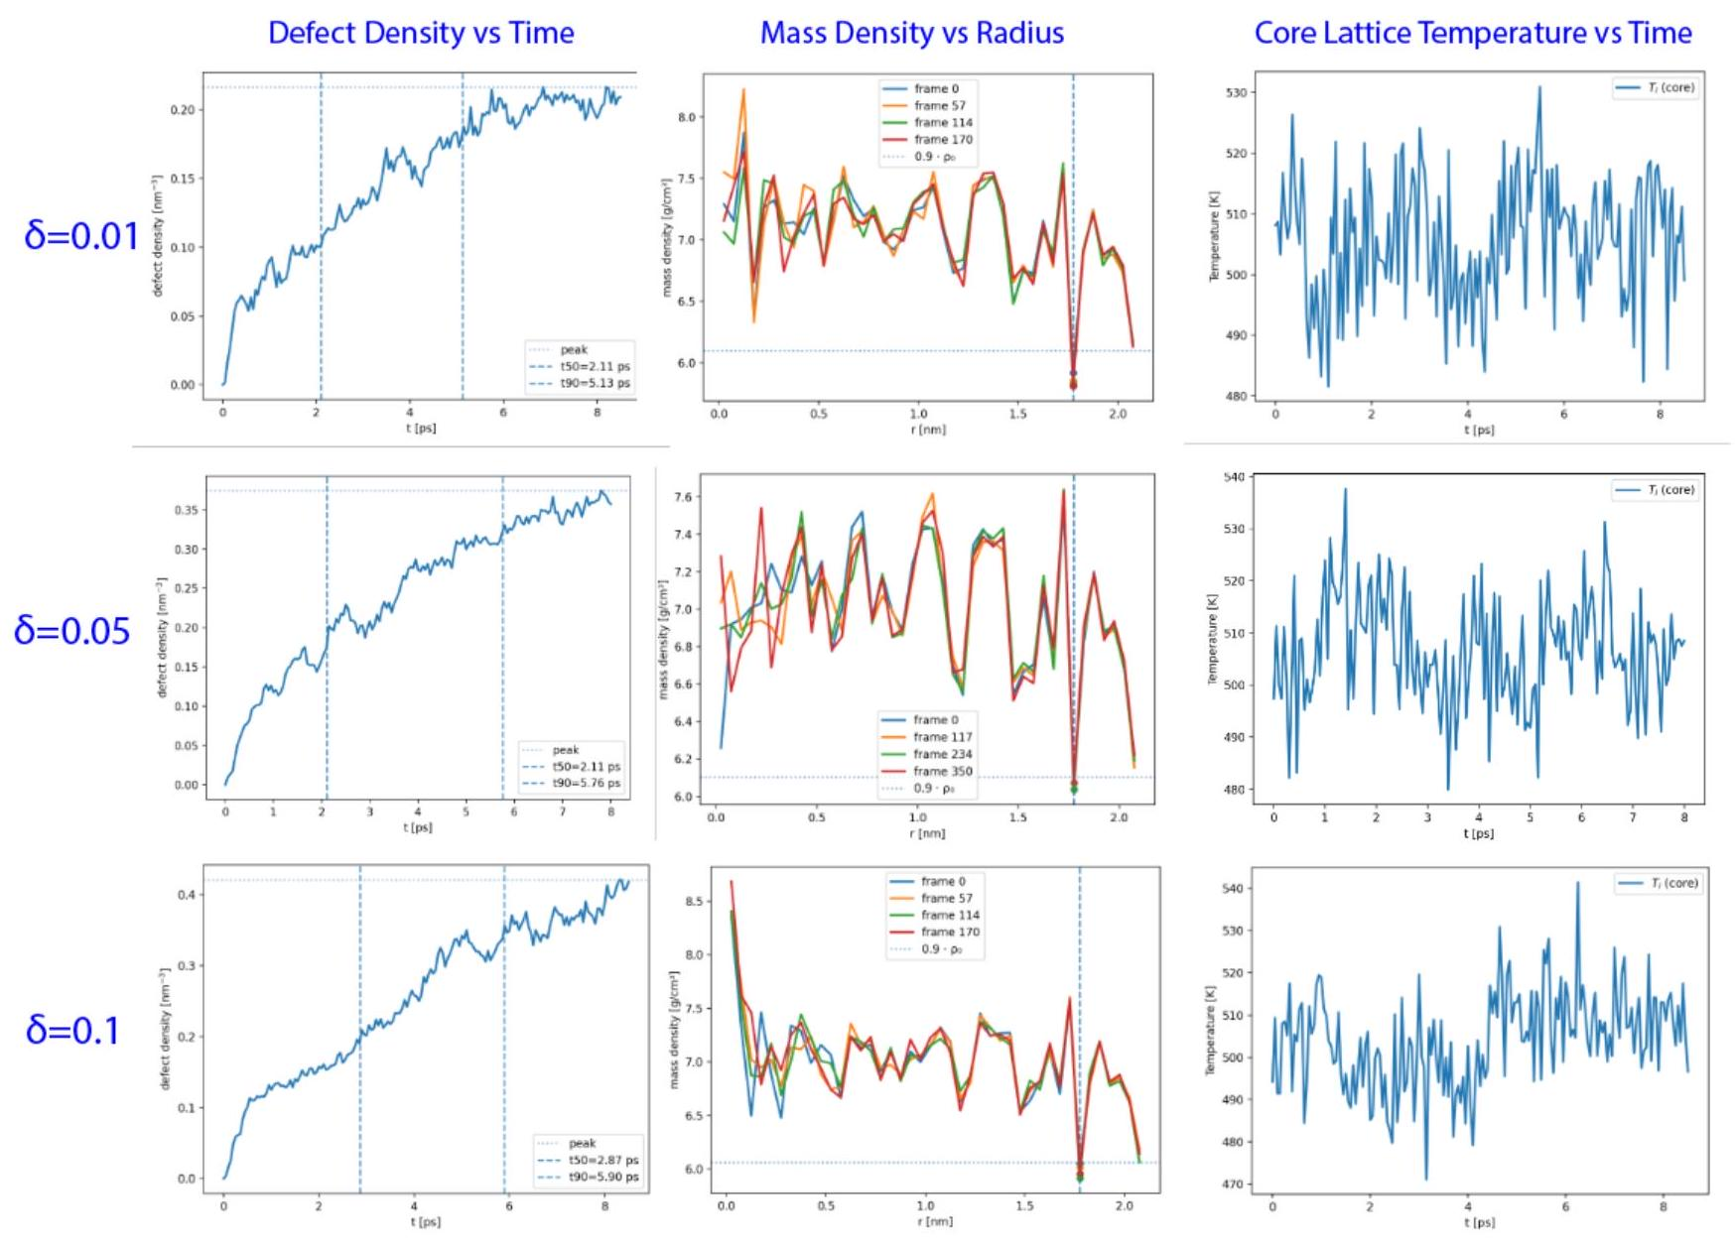
Classical MD Results
SHI Track simulations in LAMMPS with classical rigid-ion Buckingham + Coulomb potential
Simulations captured thermal disorder, point defects, and local rearrangements; did not reproduce the chemically realistic track response suggested by experiment
Core Limitation: fixed-charge classical potentials cannot represent Ce(4+) → Ce(3+) reduction.
Oxygen vacancy formation in real ceria leaves two electrons that localize on nearby Ce sites; this changes local bonding, defect energetics, migration barriers, strain, and recovery behavior.
SHI Track Simulations

Slide 25
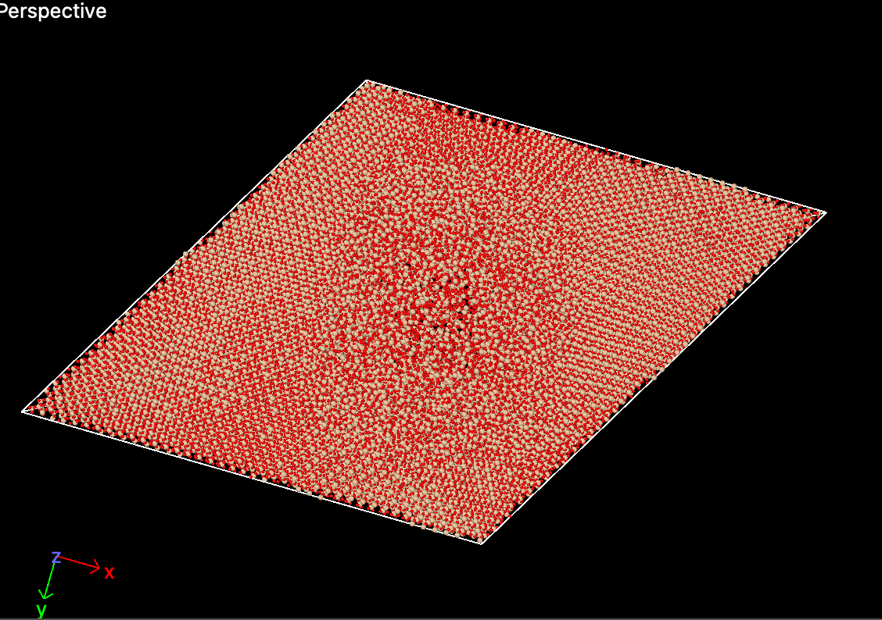
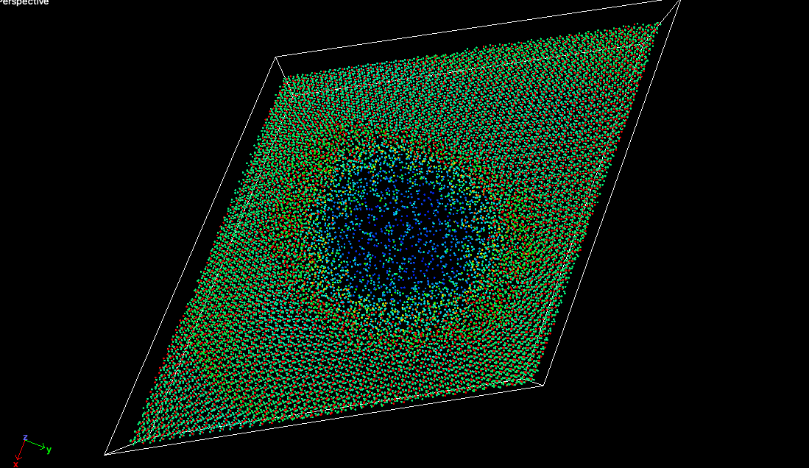
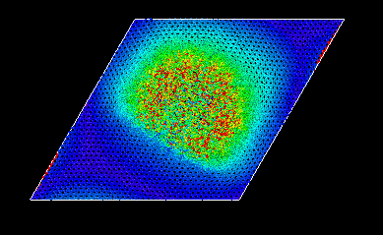
Track Analytics
Production-Size SiO2 Simulation: 166k-atom alpha-quartz cell, Vashishta Potential, Guassian SHI energy deposition (Se = 16.5 keV/nm) with cooled-rim Langevin boundary, ~1 ps relaxation
Quantitative Damage Analysis
1D-matched displacement against equilibrated reference
Central 0-2 angstrom bin shows mean displacement of 20.4 angstroms, falling off radially to undisturbed lattice
OVITO Visualizations: Displacement-colored views, local-density slice maps, and half-cell slicing for resolving the cylindrical core through the slab
SHI Track Simulations

